Slide 1


Endurance Fuel Calculations
Electric Power Load Analysis (EPLA)
Revision of 8 August 2026
Dr. Norbert Doerry
http://doerry.org/norbert/MarineElectricalPowerSystems/index.htm
© 2026 by Norbert Doerry
This work is licensed via: CC BY 4.0 (https://creativecommons.org/)

Slide 2
Essential Questions
What information is needed to perform an Endurance Fuel Calculation? | Understand
How does one obtain the information needed to perform an Endurance Fuel Calculation? | Understand
What are the results of an Endurance Fuel Calculation used for? | Understand
How is an Endurance Fuel Calculation performed? | Apply

Slide 3
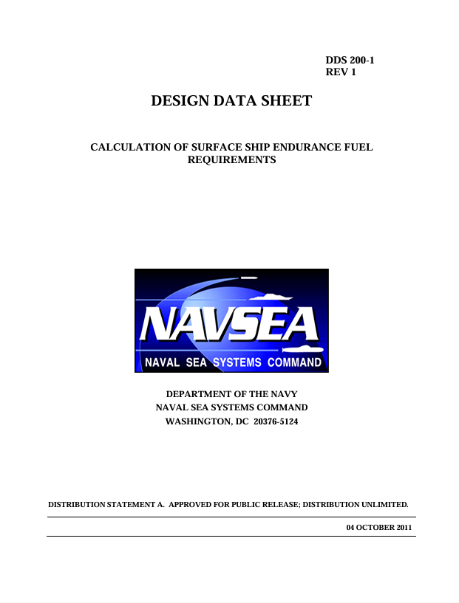
Introduction
Endurance Fuel Calculation are used to determine the size of the fuel tanks
Size of fuel tanks depends largely on
  How far one wants to go (or how much time one wants to go)
  How fast one wants to go
  What operational condition one is in while going
DPC 200-1 (formerly DDS 200-1)
  Defines procedure for calculating endurance fuel requirements
  Applicable to naval ships, but may be adapted to commercial ships

Slide 4

Owner’s (Service) Requirements
Economical Transit
  Economical transit distance (nm)
  Endurance speed (knots)
Surge to Theater
  Surge to Theater Distance (nm)
  Sustained speed (knots)
Operational Presence
  Operational mission
  Speed-time profile (knots vs % time)
  Operational presence time (hours)
Operational Condition: Cruise with self-defense
Operating area may also be specified or use default: North Pacific
One with largest fuel requirement used for determining fuel tank capacity
Ambient condition profile may also be specified or use default:

Slide 5
Ship design details needed
Electric Power Load Analysis (EPLA)
Generator set, conversion equipment efficiencies
Electrical Power System Concept of Operations (EPS-CONOPS)
  Includes generator set scheduling table
Propulsion System Concept of Operations (PS-CONOPS)
  Includes propulsion scheduling table
Propulsion speed-power curve
Propulsion system efficiency data
Generator set and propulsion prime mover specific fuel consumption curves
Plant deterioration allowance (default 1.05)
Sea state and fouling factor (default 1.10 for early-stage design)
Tailpipe allowance (tanks: broad and shallow 0.95; narrow and deep 0.98)
  Fuel suction cannot completely empty the fuel tank

Slide 6
Economical Transit burnable fuel load
(Units are metric tons)
Calculated Economical Transit Fuel Rate (kg/h)
  Sum of fuel rates for propulsion and ship service electrical generation prime movers.
  Propulsion power from each propulsion unit determined from speed power curve of online propulsion units and from propulsion scheduling table.
  Ship service power provided by each generator set determined from 24-hour average ship service endurance electric power averaged over ambient condition profile (from EPLA) and generator scheduling table.
  Fuel rates for each prime mover determined from prime mover sfc curves.

Slide 7
Surge to Theater burnable fuel load
(Units are metric tons)
Calculated Surge to Theater Fuel Rate (kg/h)
  Calculated in analogous way as the Calculated Economical Transit Fuel Rate (kg/h)

Slide 8
Operational Presence burnable fuel load
(Units are metric tons)
Calculated Operational Presence Fuel Rate (kg/h)
  Sum of fuel rates for propulsion and ship service electrical generation prime movers averaged using the percent of time for each speed in the operational profile.
  Propulsion power from each propulsion unit determined from speed power curve of online propulsion units and from propulsion scheduling table for each speed in the operational profile.
  Ship service power provided by each generator set determined from 24-hour average ship service endurance electric power averaged over ambient condition profile (from EPLA) and generator scheduling table.
  Fuel rates for each prime mover (for each speed in the operational profile) determined from prime mover sfc curves and the amount of power provided by each prime mover.

Slide 9
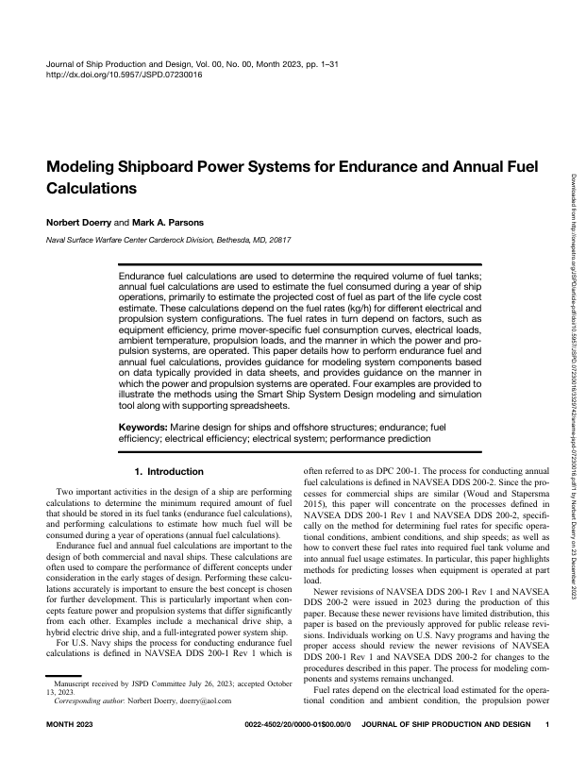
Calculating Fuel Rates
Specific method for calculating fuel rates depends on the details of the electrical power and propulsion architecture, the EPS-CONOPS, and the PS-CONOPS
For details on modeling see:
  Doerry, Norbert, and Mark A. Parsons, "Modeling Shipboard Power Systems for Endurance and Annual Fuel Calculations," SNAME J Ship Prod Des (2023)
Also see DPC 200-1 for worked examples

Slide 10
Calculating Required Fuel Tank Volume
Design Endurance Fuel Load
  Divide the largest of the three burnable fuel loads by the tailpipe allowance
Convert to volume
  The specific gravity of F76 fuel is about 0.84 kg/L (see DPC 200-2)
  There are 1000 liters in a cubic meter
  Hence specific gravity of F75 fuel is about 840 kg/m³
Add in allowances
  Additional 5% volume for expansion of fuel
  Additional volume (typically 2%) for internal structure

Slide 11
Special Cases
See DPC 200-1 for special cases
High speed ships
  Accounts for reduction in drag as fuel is consumed
Efficient high-speed operations
  In some cases, ships can operate more economically at a higher speed than the economical transit speed
  Ships that employ foils or other lifting surfaces may be in this category
Using a profile to achieve economical transit speed on average
  In some cases, ships can operate more economically when operating a portion of the time at a speed higher and the remaining time at a speed lower than the economical transit speed
  Hybrid electric drive ships may be in this category

